Slide 1

Load Test – Ecommerce Site
User Guide and Observations
Created By,
Deepikadevi Thiyagarajan

Slide 2
Code base and Jenkins Details
Git Repository
https://github.com/Deepika-TestAutomationUser/ECommerce-LoadTest-Project-
Branch : Main
UserName:deepikadevi.testautomation@gmail.com
Password:March%2022
Software requirement to run in local
Apache Jmeter Open source software
Project can be imported directly for execution

Slide 3
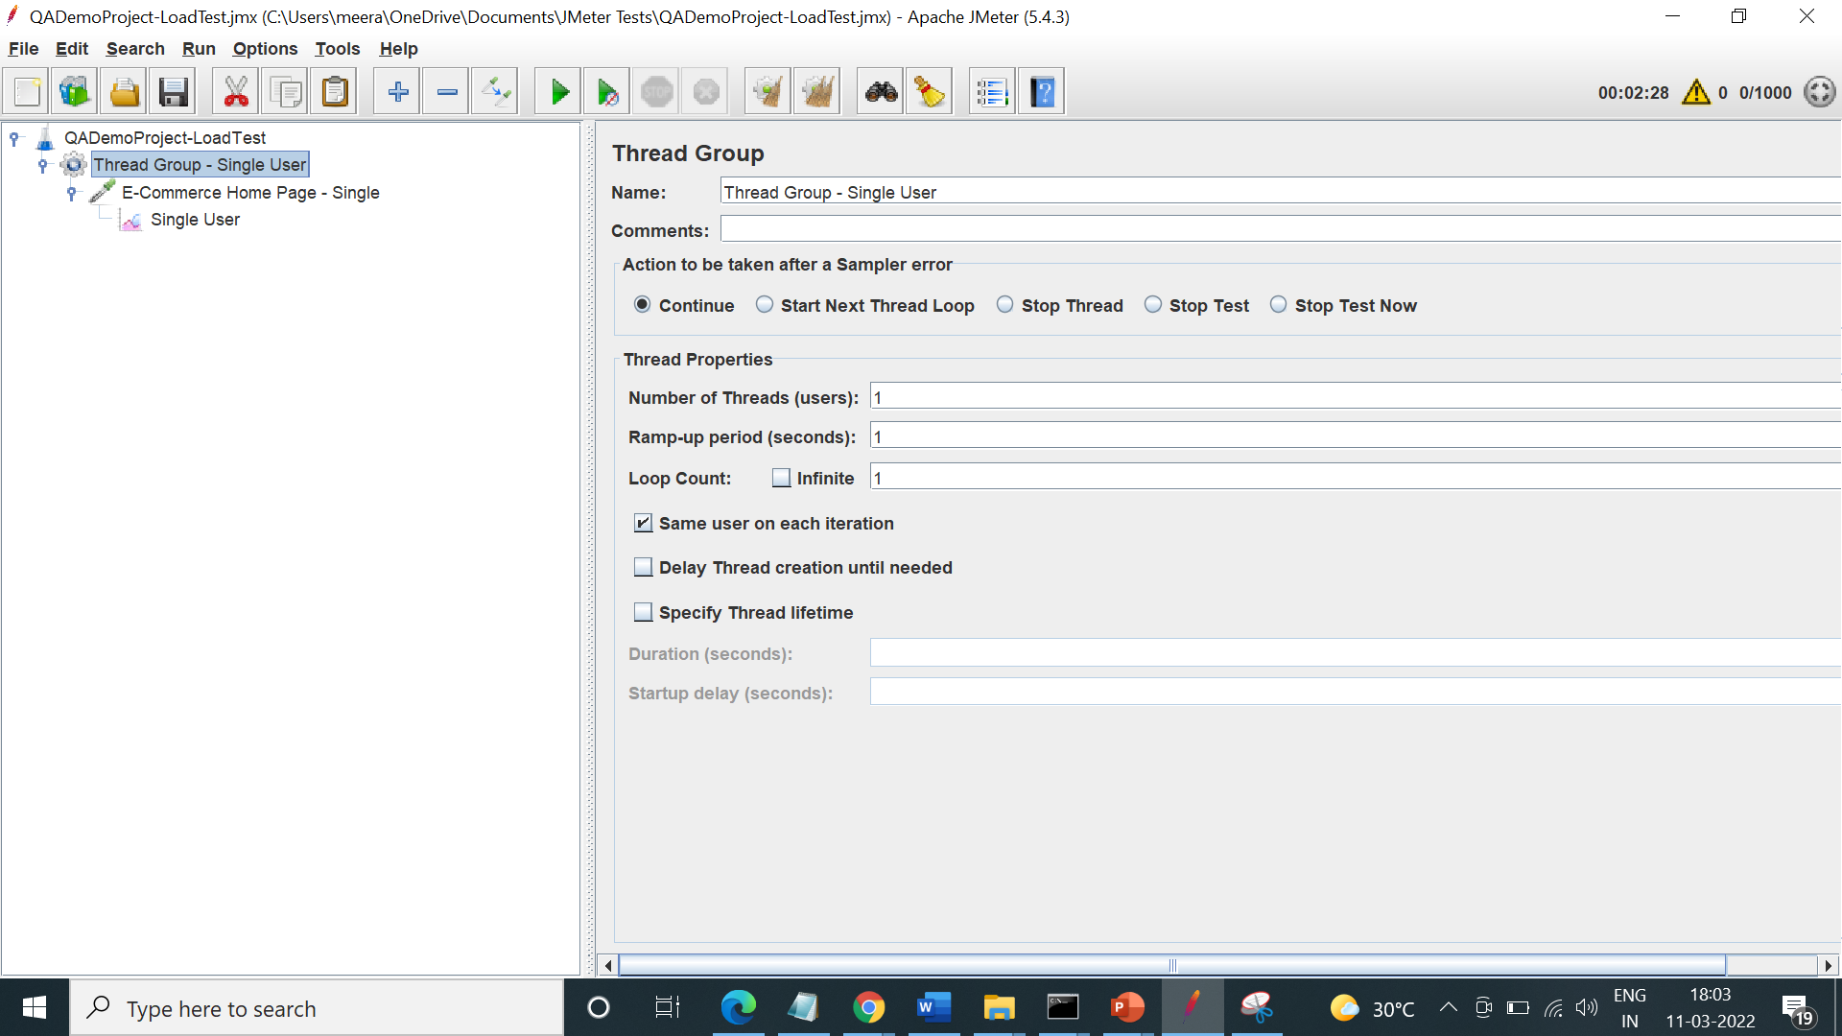
Load Testing Project
Single User

Slide 4
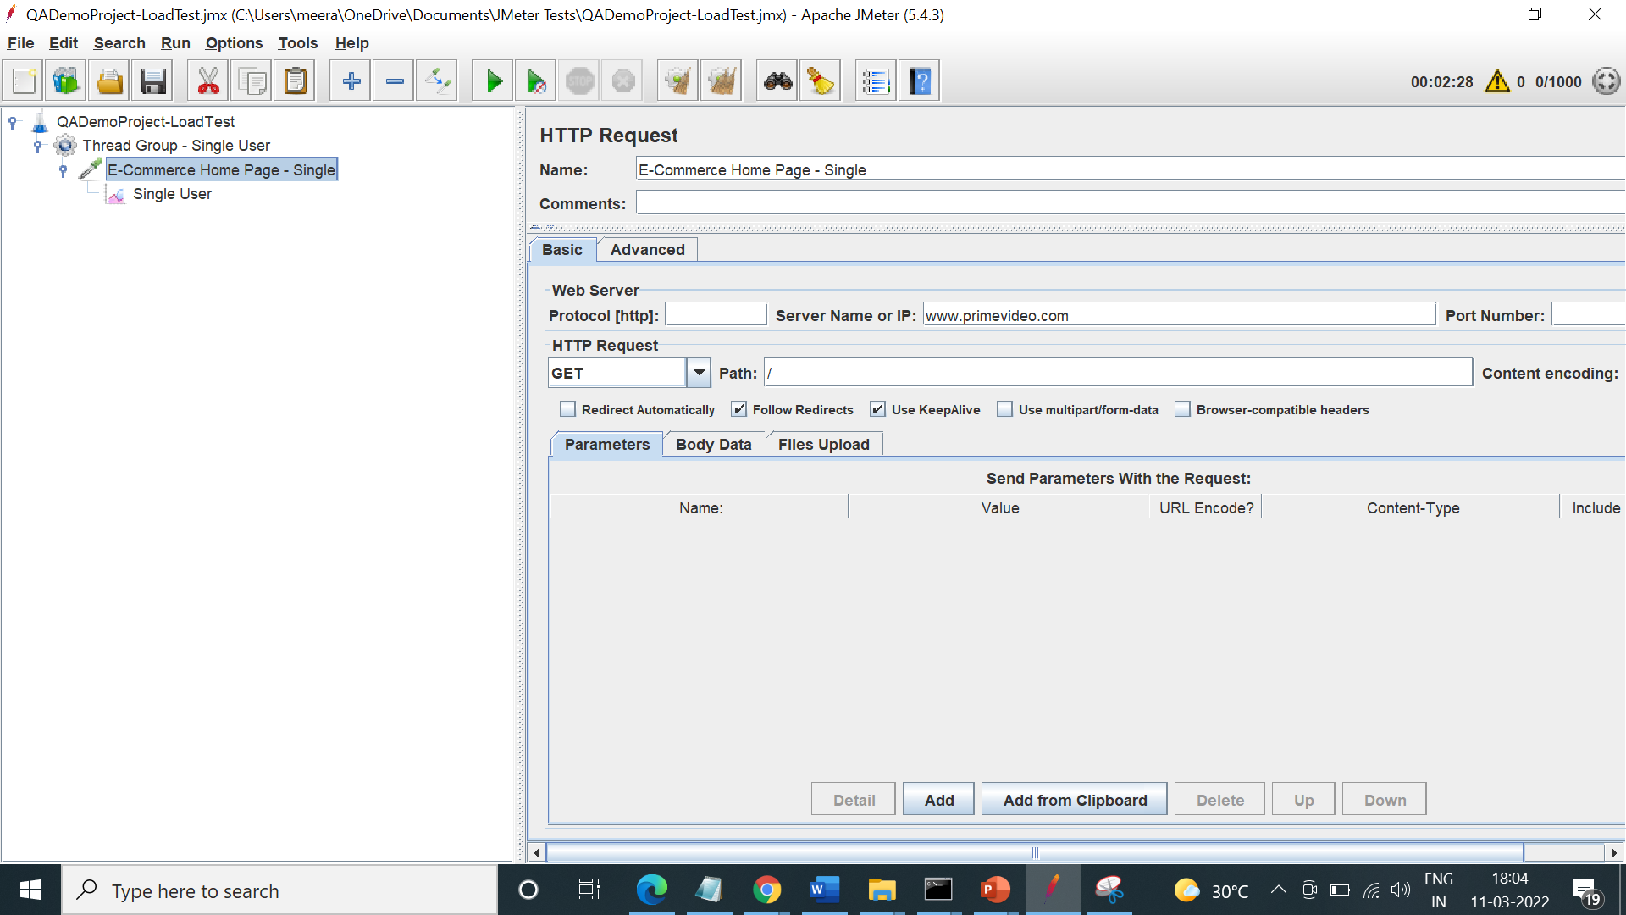
Load Testing Project
Single User

Slide 5
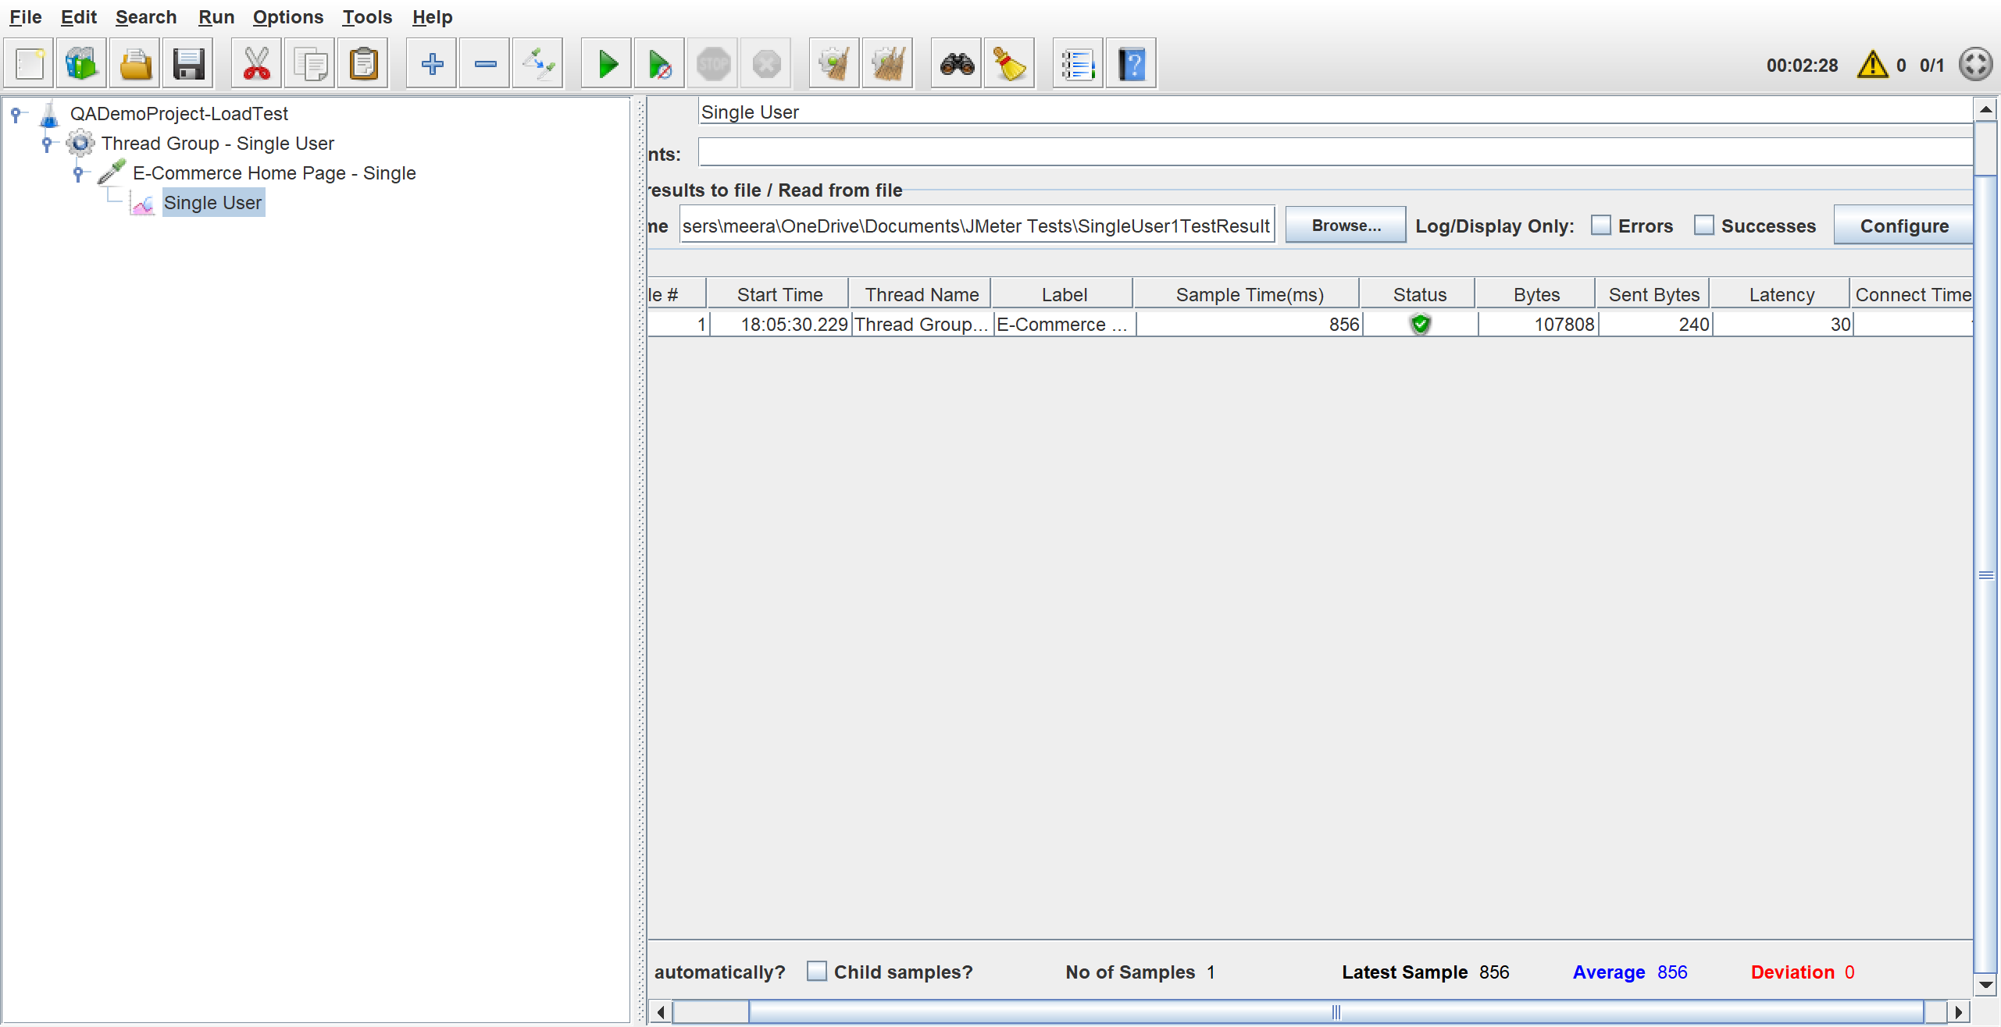
Load Testing Project
Single User

Slide 6
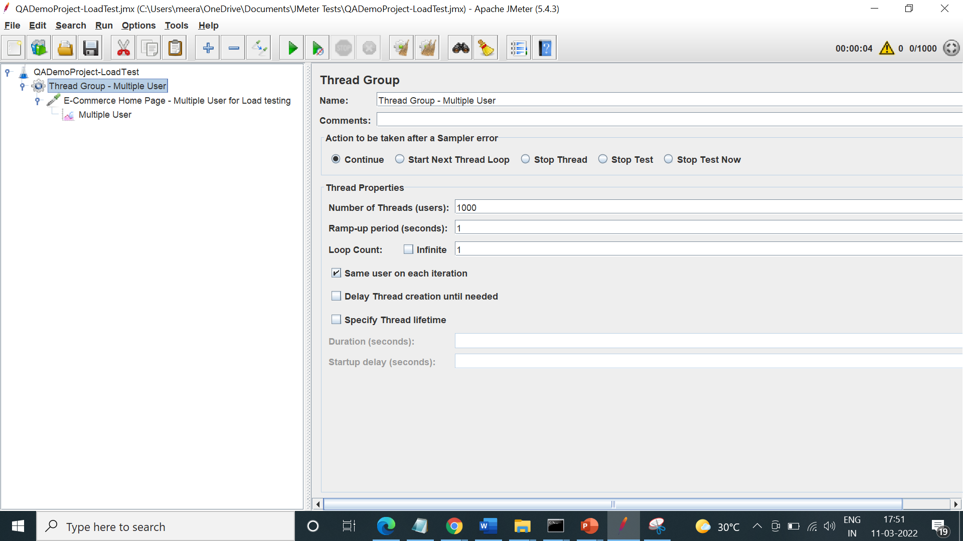
Load Testing – Multiple User
Jmeter Project

Slide 7
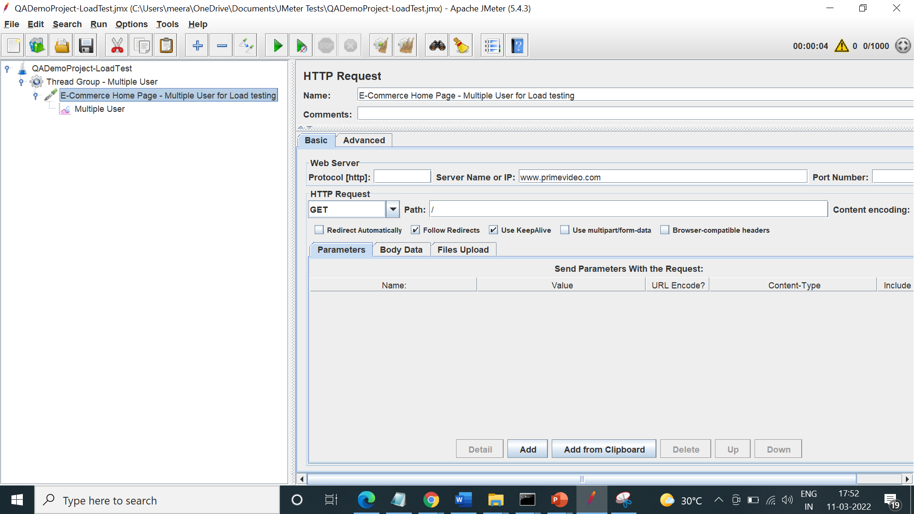
Load Testing Project
Jmeter Project

Slide 8
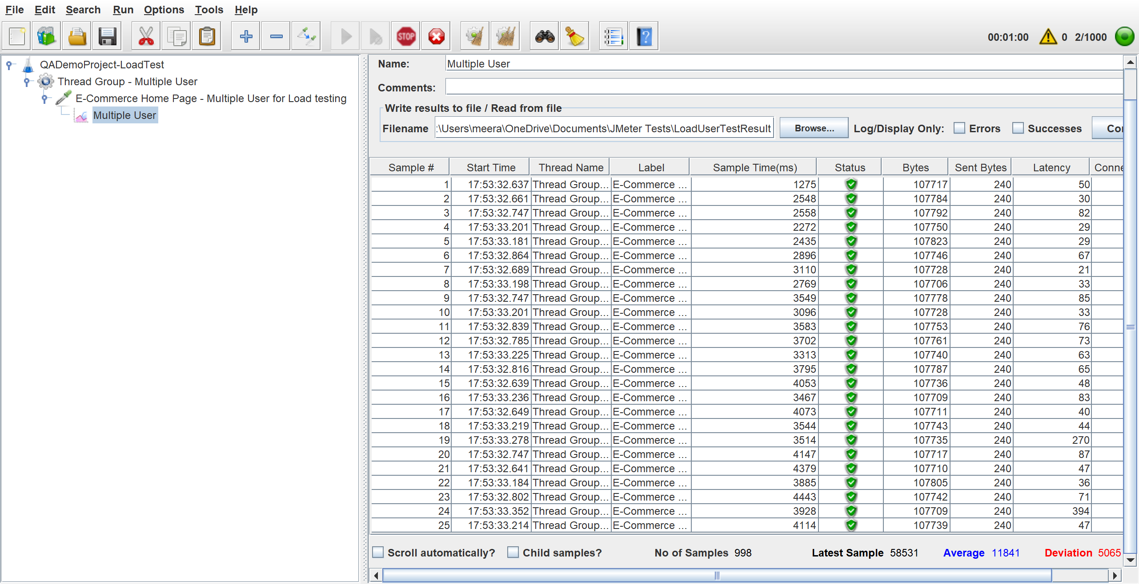
Load Testing Project
Jmeter Project

Slide 9
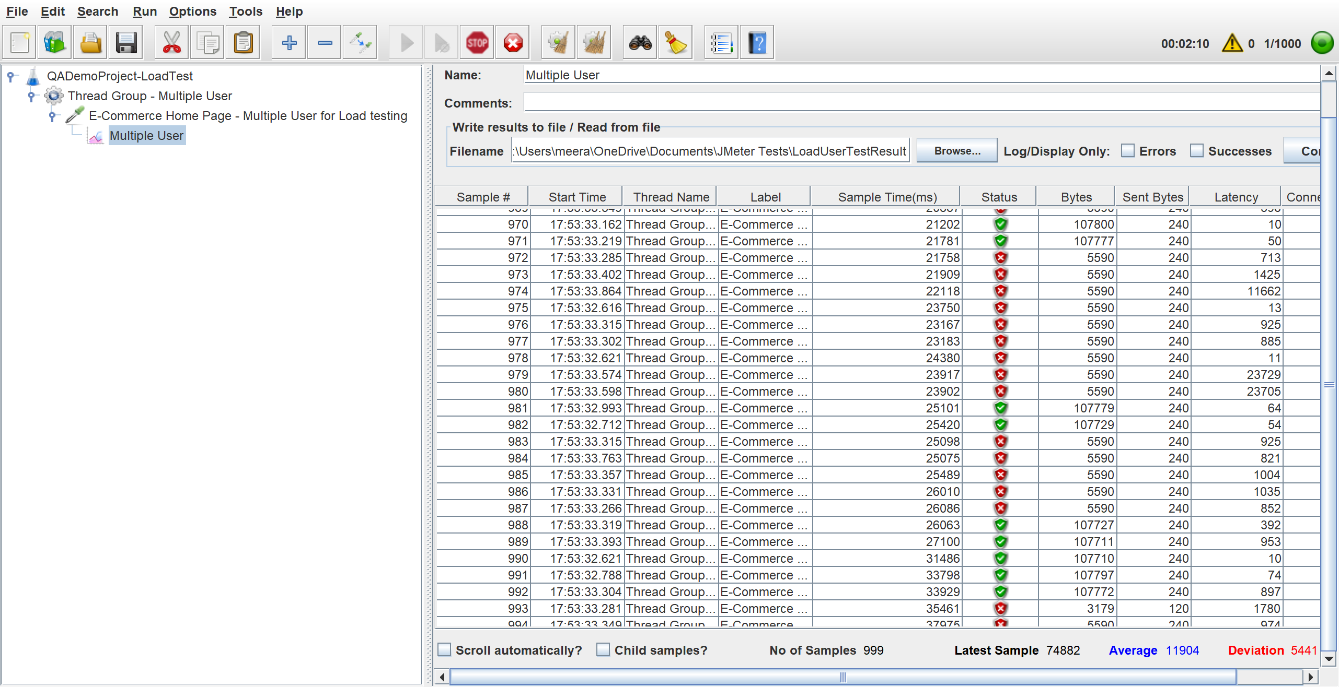
Load Testing Project
Jmeter Project

Slide 10
1. Did the load test have an impact on the web application response time?
Response Time for Single User – 856 ms
Response Time for Load 1000 User – Ranged between 1275 -37975 ms

Slide 11
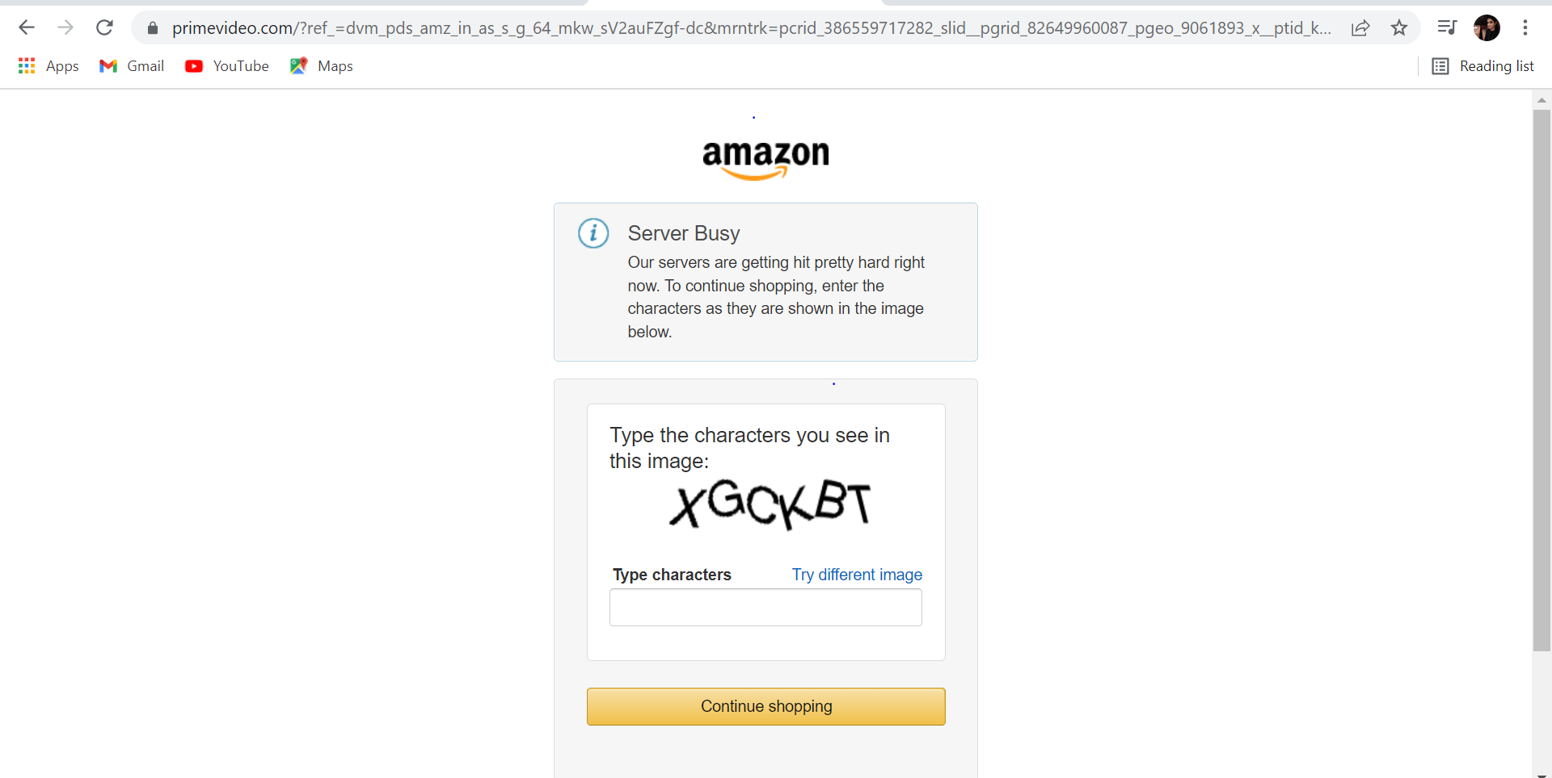
1. Did the load test have an impact on the web application response time?
Below attached error observed during load test

Slide 12
2. Analyze a few HTTP/S responses
Below mentioned response code observed during load test
200 – OK - The HTTP 200 OK success status response code indicates that the request has succeeded.
503 - Service Unavailable -The HyperText Transfer Protocol (HTTP) 503 Service Unavailable server error response code indicates that the server is not ready to handle the request. Common causes are a server that is down for maintenance or that is overloaded.
301 - Moved Permanently -The HyperText Transfer Protocol (HTTP) 301 Moved Permanently redirect status response code indicates that the requested resource has been definitively moved to the URL given by the Location headers

Slide 13
3. What is the optimal application response time for modern day web applications?
A one-second response time is generally the maximum acceptable limit, as users still likely won't notice a delay.
Anything more than one second is problematic, and with a delay of around five or six seconds a user will typically leave the website or application entirely.
Complex applications can extend to 1-2 seconds with partial loading to engage users

Slide 14


